Slide 1
Final Project Presentation
( IOT FUNDAMENTAL- 2102541 )
FULL STACK DEVELOPMENT OF SMART WEATHER STATION
Presented by:
(6672006421) Chanreng Sey Nhim
(6673008921) Mazhar Ali
(6572072721) Mohammad Jawad Fareed

Slide 2










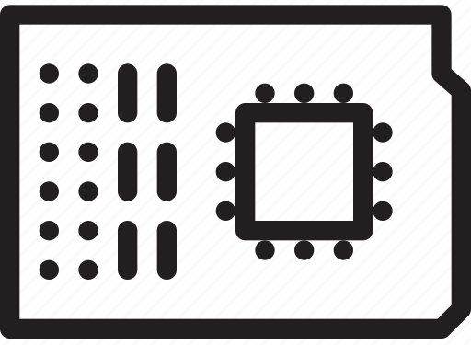




I. System Architecture
Raspberry Pi
IoTCloudServe@TEIN
WLAN
Subscribe data
Write data
EMQX
Consumer
Rancher
InfluxDB
Docker Container
Public data
Write data
Read data
Cucumber-Rs
Post
Data Analytics
Sensor
Grafana
°C
%RH
kPa
1

Slide 3
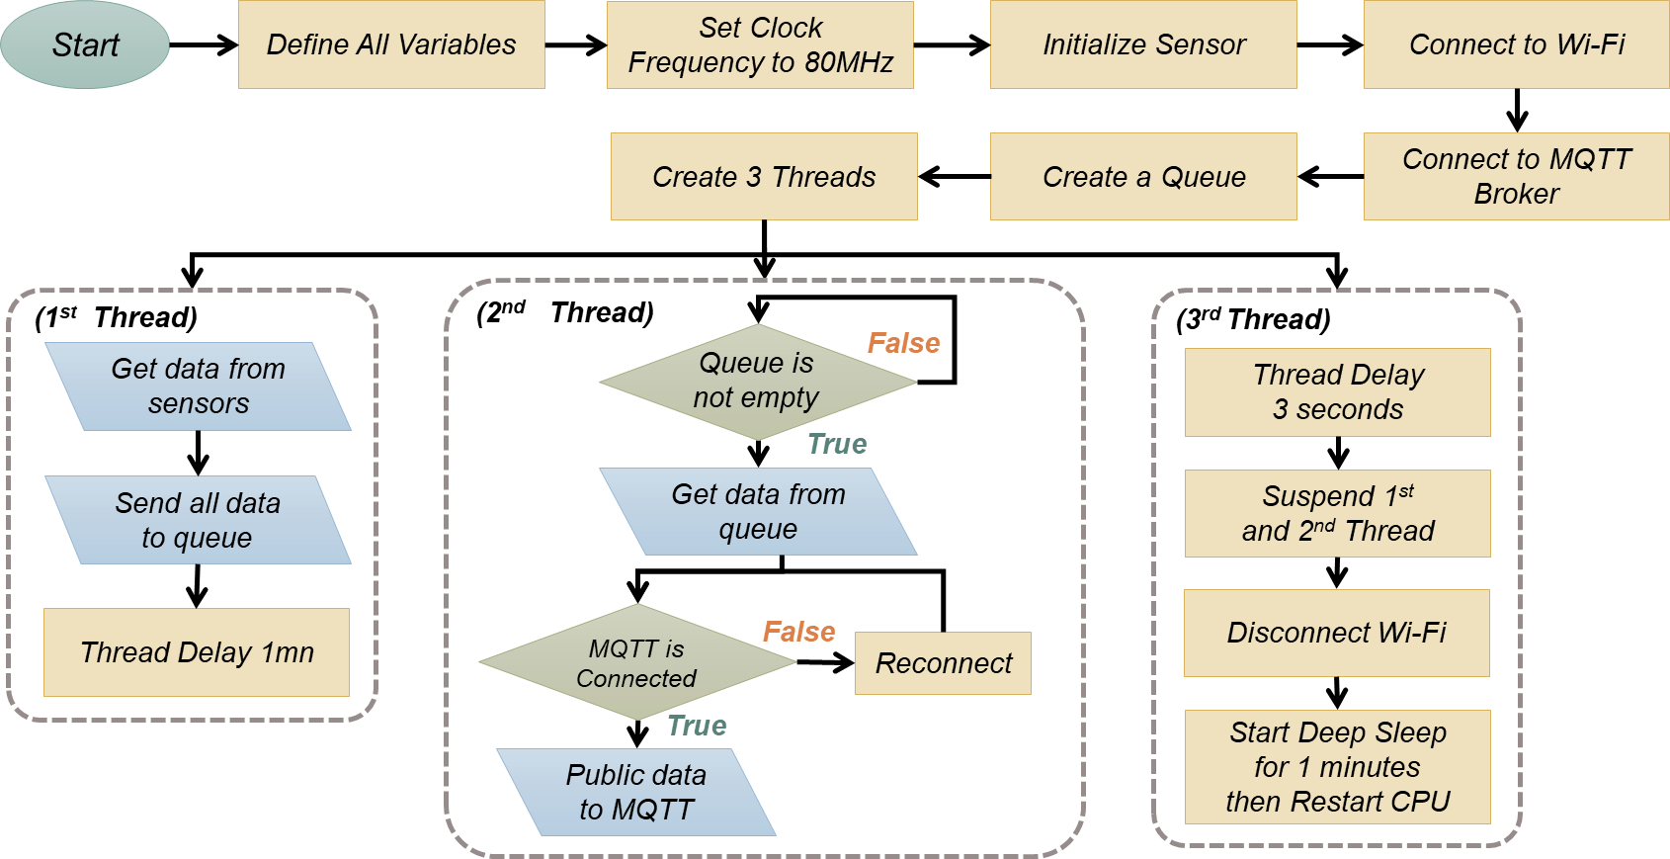
II. Cucumber-RS Programming
Flowchart of Programming on Cucumber-RS
2

Slide 4
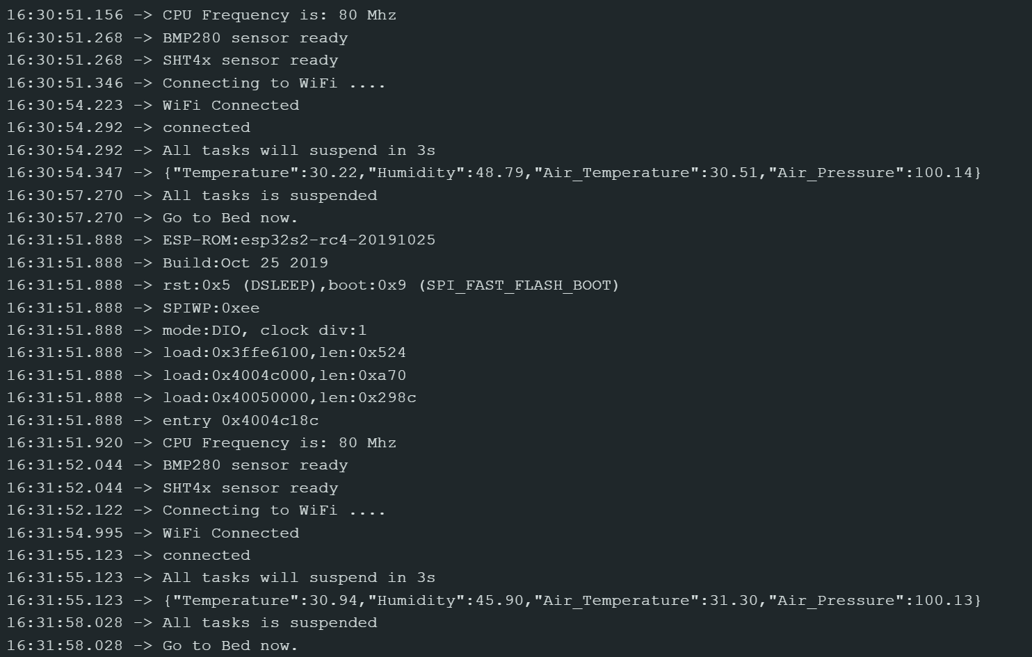
II. Cucumber-RS Programming
Output Data from Serial Monitor on Arudino-IDE
3

Slide 5
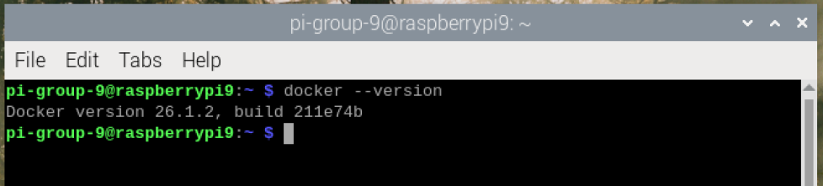
III. Raspberry Pi
Raspberry Pi
EMQX
Docker Container
Consumer
Install the Docker Container on Raspberry Pi
Command to install docker container on Raspberry Pi
|> curl -sSL https://get.docker.com | sh
|> sudo usermod -aG docker $USER
|> docker –version
Docker version is installed on Raspberry Pi
4

Slide 6
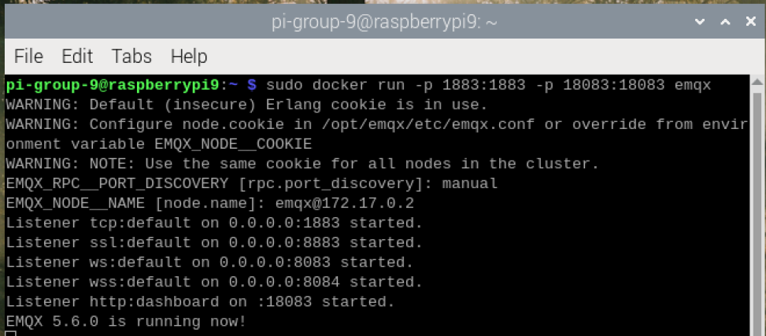
3.1. Install and Run EMQX as MQTT Broker
Install EMQX Image then Run on Docker Container
We will use port 1883 for MQTT Broker and 18083 for EMQX UI management:
|> sudo docker run -p 1883:1883 -p 18083:18083 emqx
5

Slide 7
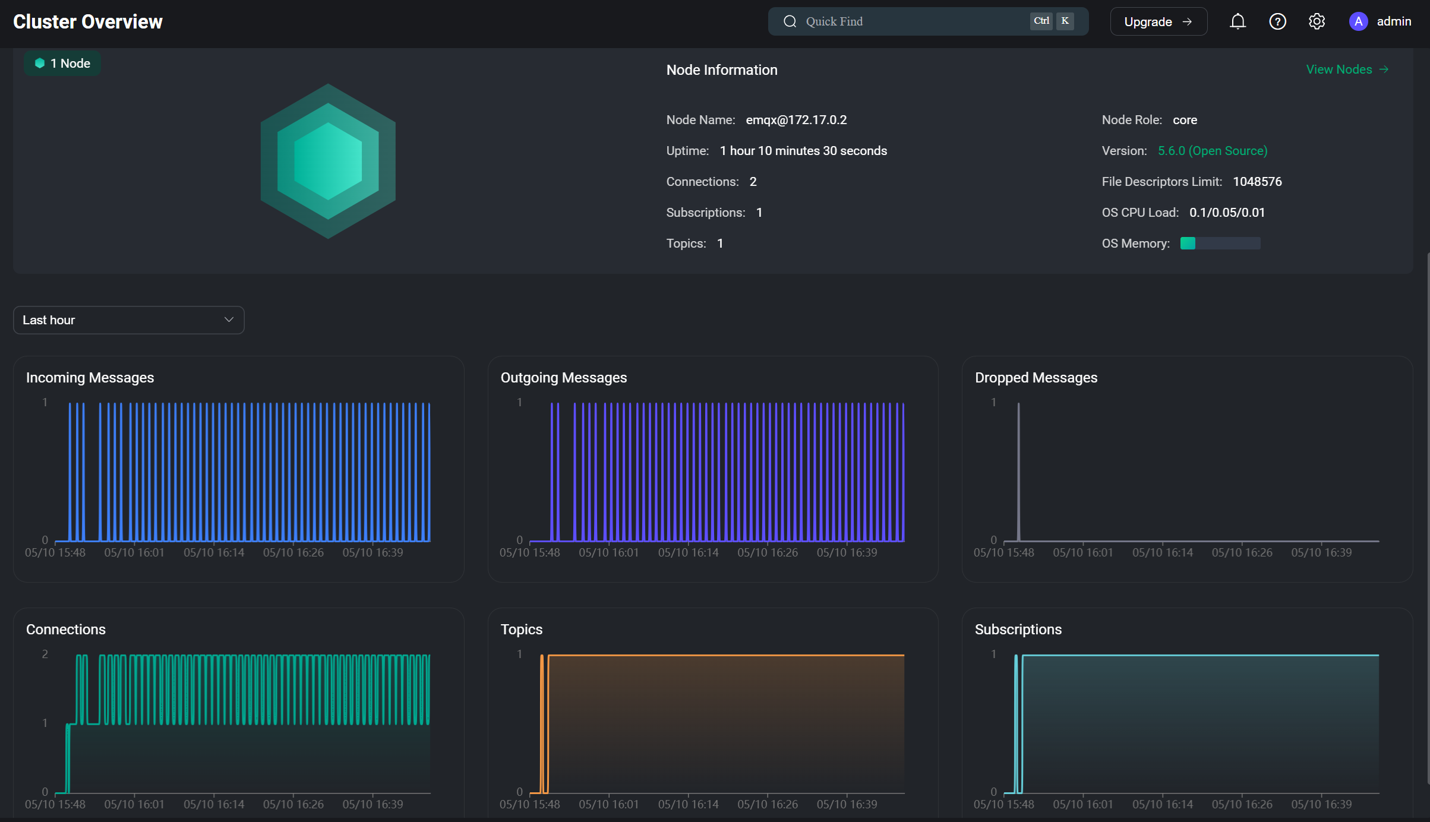
3.1. Install and Run EMQX as MQTT Broker
Go to raspberrypi9.local:18083 to verify it run on docker container now.
(Note: PC must connect to WLAN with Raspberry Pi, Username: admin; Password: public)
6

Slide 8
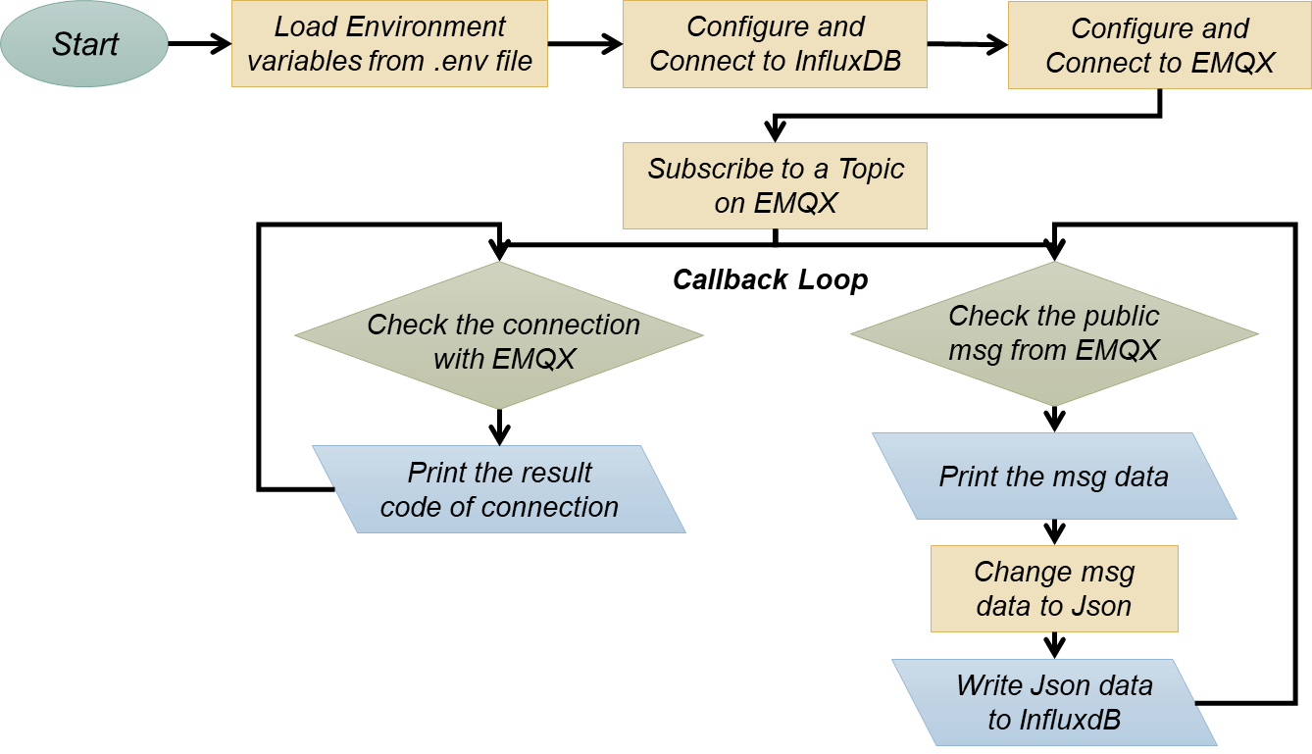
3.2. Create a Consumer on Raspberry Pi
Algorithm of Consumer
7

Slide 9
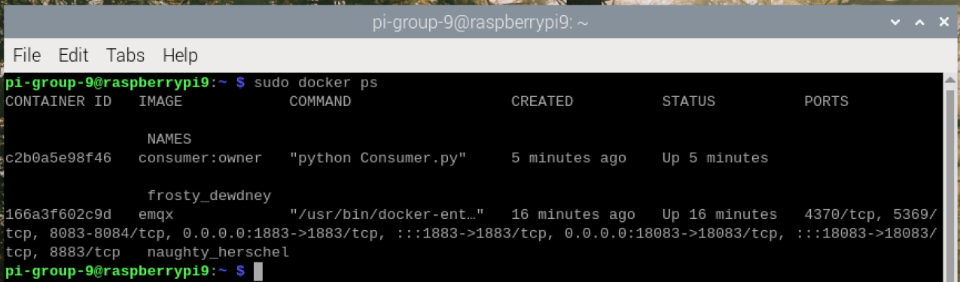
3.3. Build a Consumer as Docker Image
Build and Run it on Docker Container
|> git clone https://github.com/Rengsey/IoT_Fun_Final_Project_G9.git
|> cd IoT_Final_Project_G9/Raspberry_Pi/Consumer
|> source pivenv/bin/activate
|> pip install requirements.txt system-broke-packages
|> python consumer.py
|> sudo docker build -t consumer:owner .
|> sudo docker images
|> sudo docker run --env-file=.env consumer:owner
|> sudo docker ps
8

Slide 10
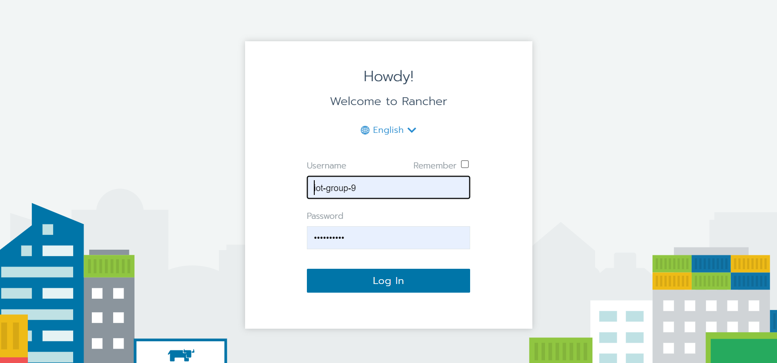
IV. Deployment on the Cloud Server
IoTCloudServe@TEIN
Rancher
InfluxDB
Grafana
Data Analytics
Login in Rancher: https://www.iotcloudserve.net/
9

Slide 11
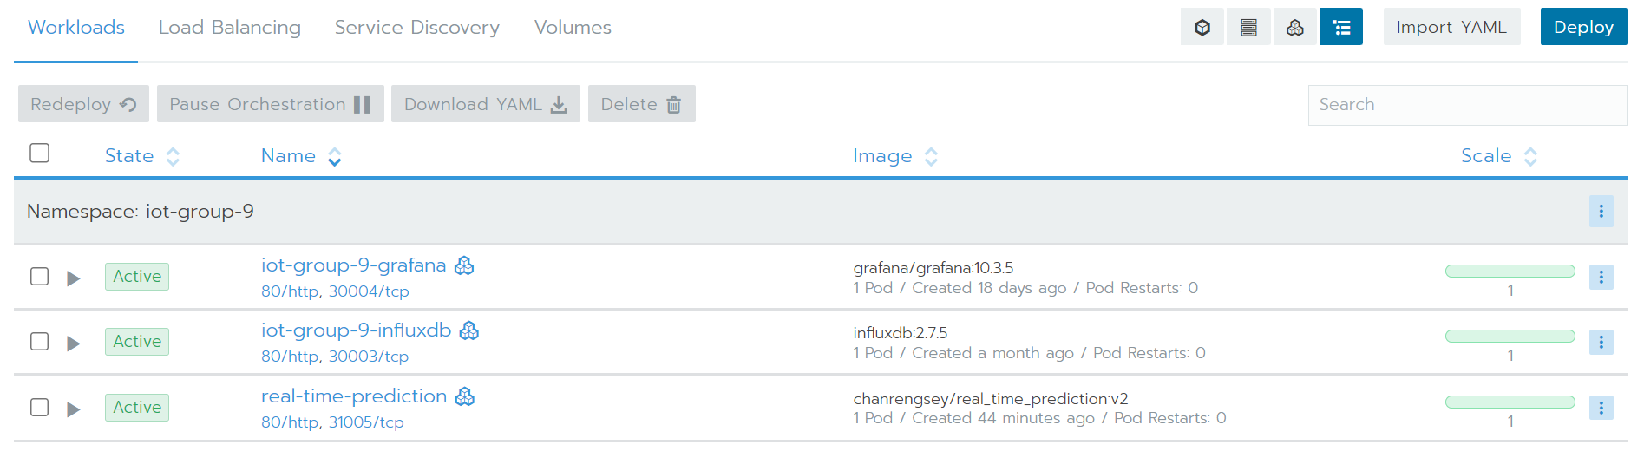
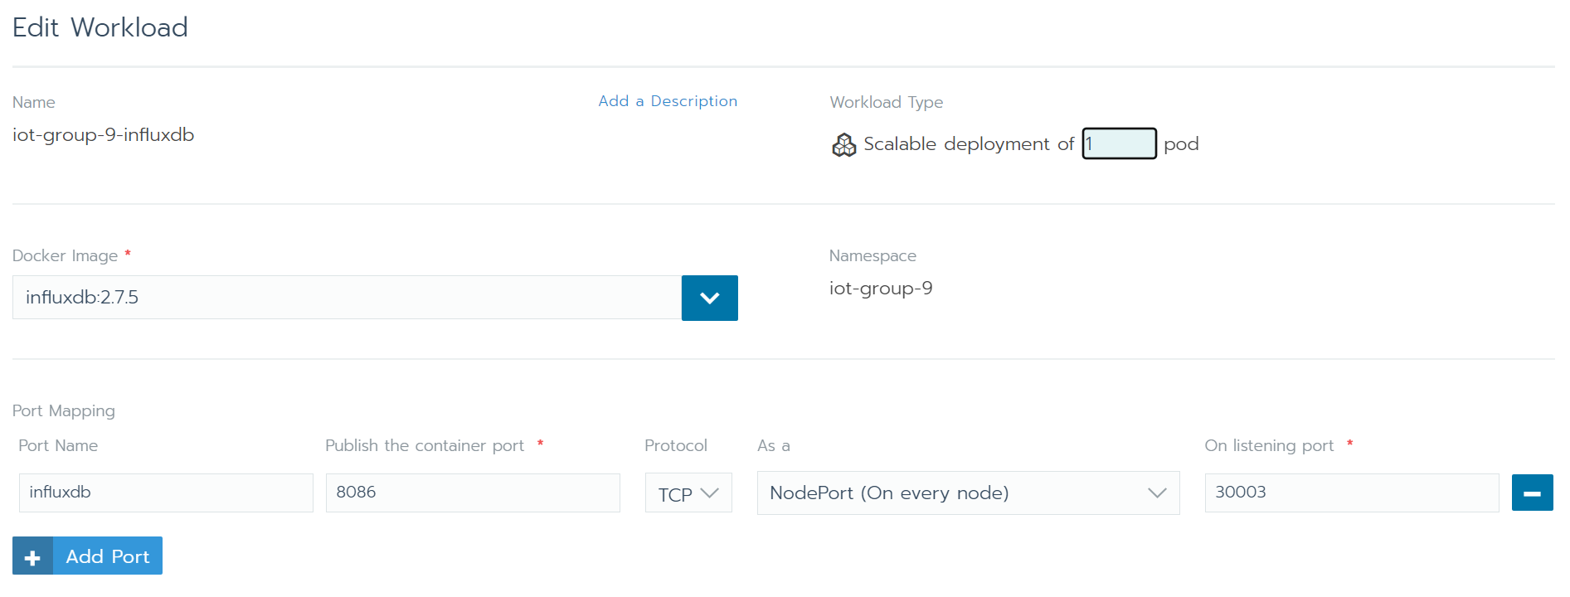
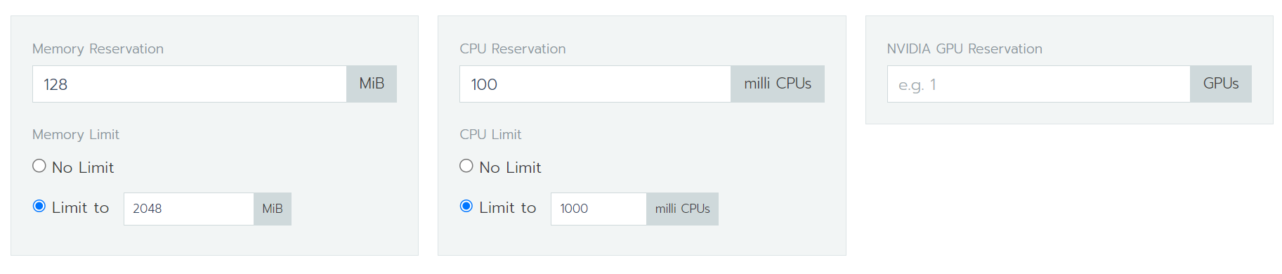
4.1. Deploy InfluxDB on Rancher
10

Slide 12
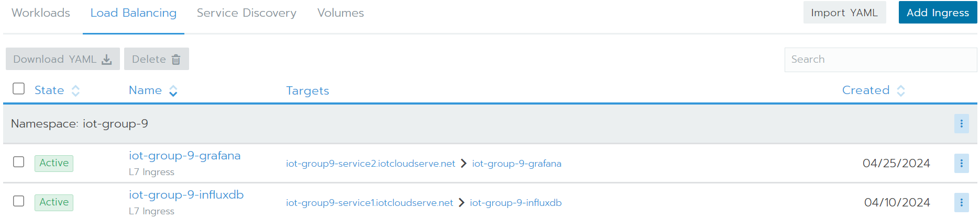
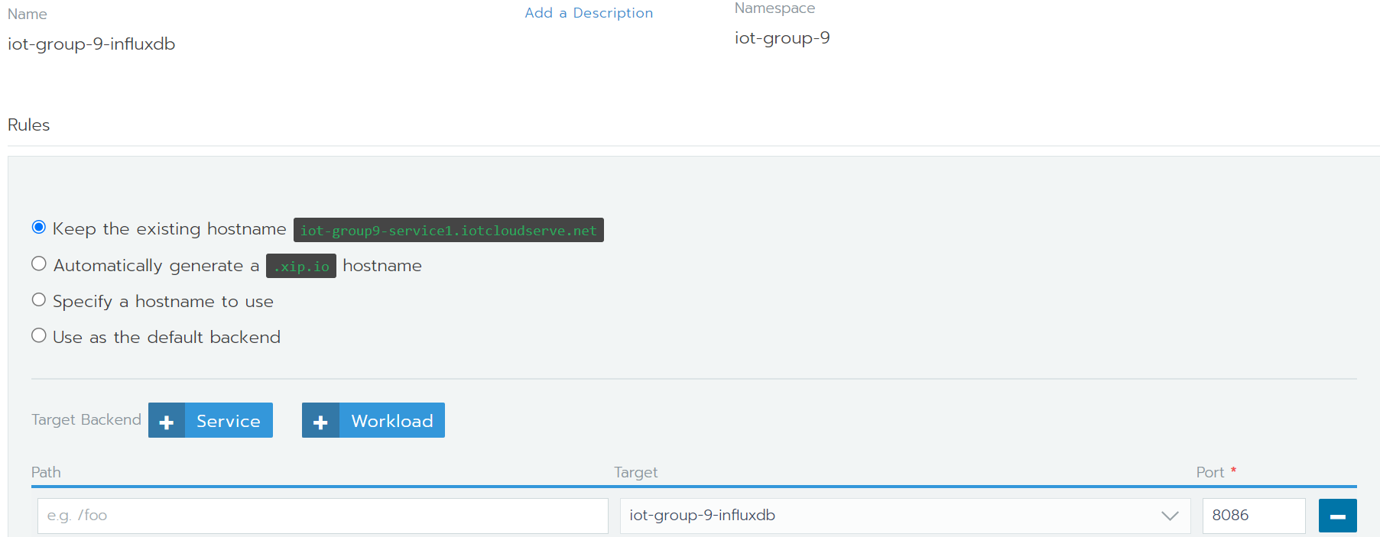
4.1. Deploy InfluxDB on Rancher
11

Slide 13
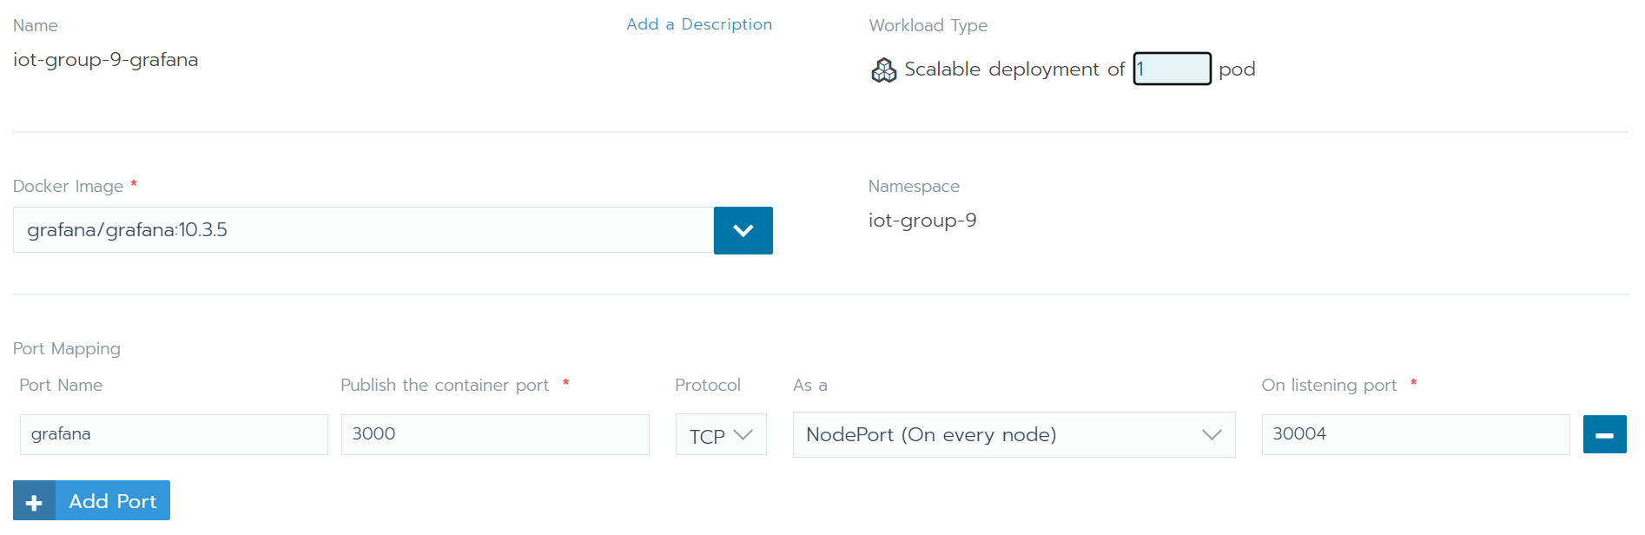
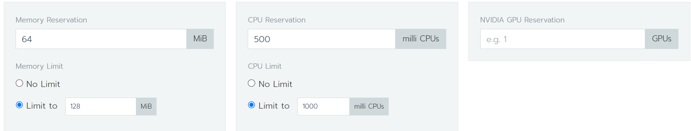
4.2. Grafana Deployment on Rancher
12

Slide 14
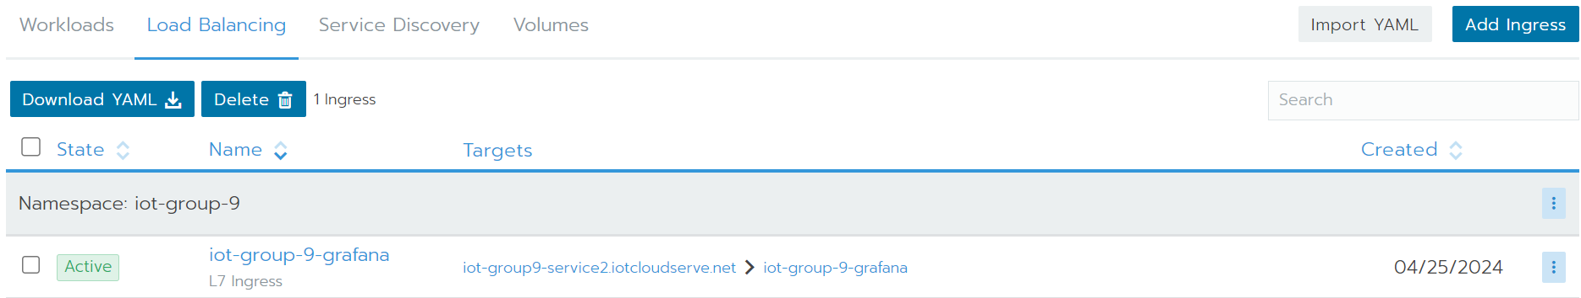
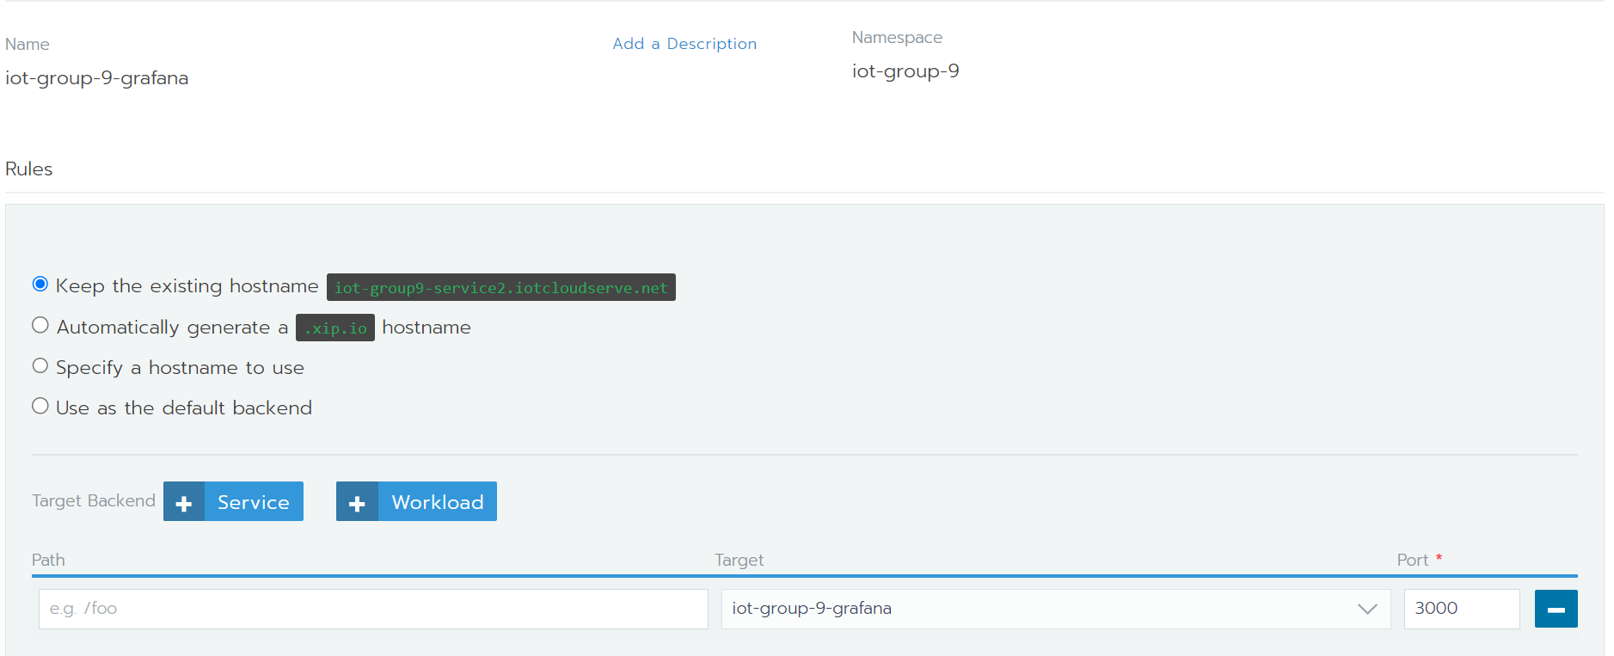
4.2. Grafana Deployment on Rancher
13

Slide 15
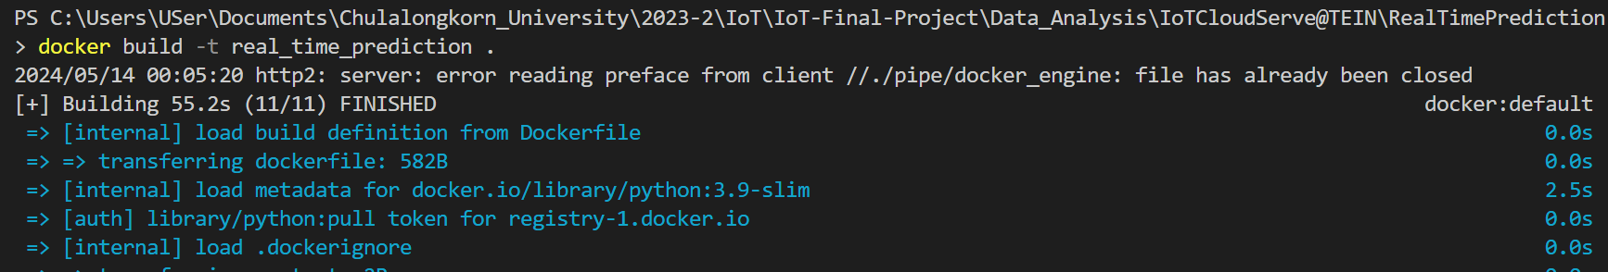
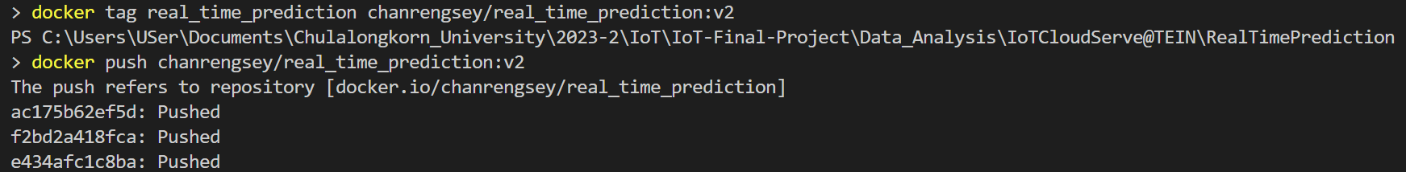
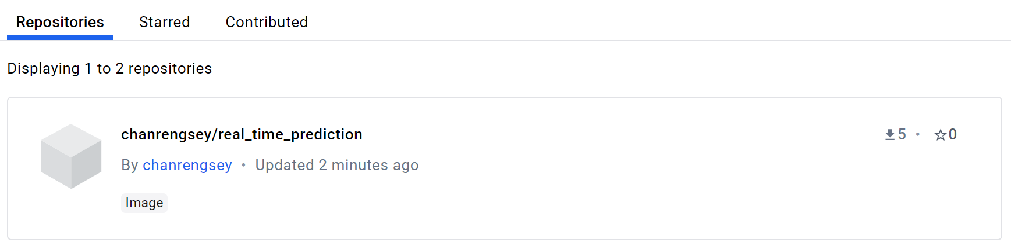
4.3. Data Analytic Deployment
Build firmware prediction as a docker image
Tag new name and Push to Docker Hub
Image is pushed to Docker Hub successful
14

Slide 16
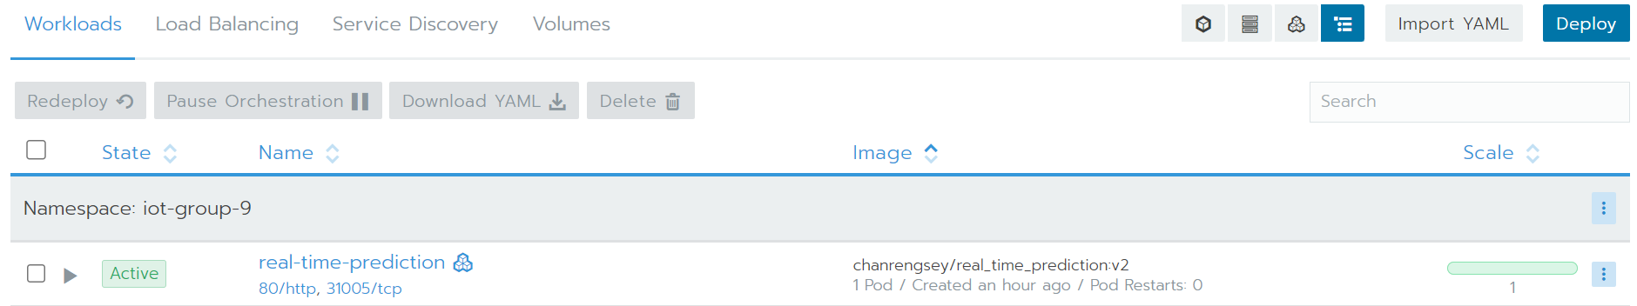
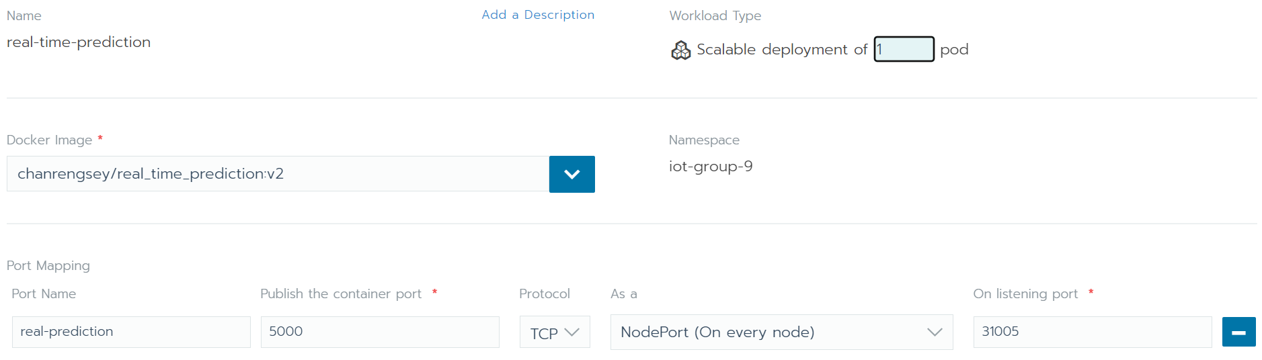
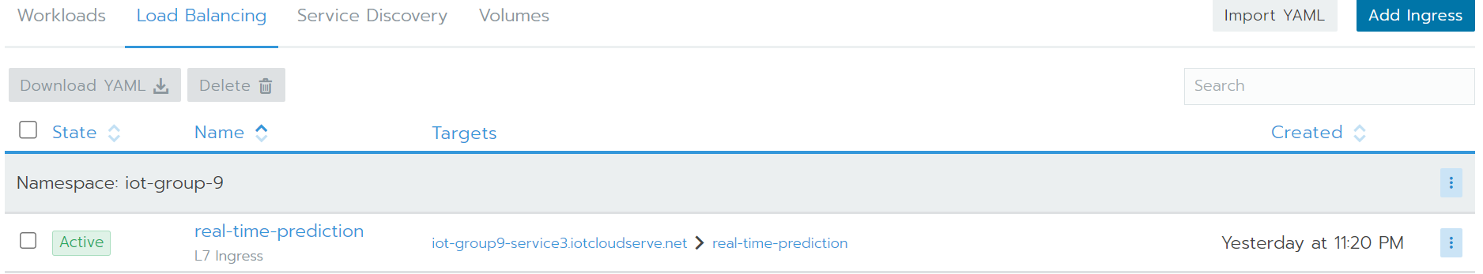
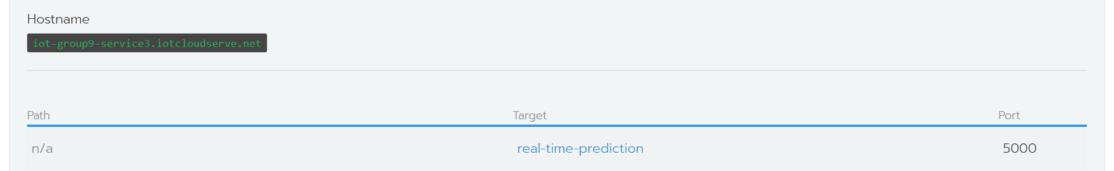
4.3. Data Analytic Deployment
15

Slide 17
V. Designing of Dashboard on Grafana
InfluxDB: InfluxDB is a specialized database designed to handle data that changes over time, such as temperature, humidity and any other parameters measurements from sensors. It can quickly store and manage lots of data that comes in continuously.
Grafana: Grafana is a tool that lets you make and share interactive charts and graphs using data from various sources like InfluxDB. It helps you visualize data in a way that's easy to understand, allowing you to see trends and patterns.
16

Slide 18
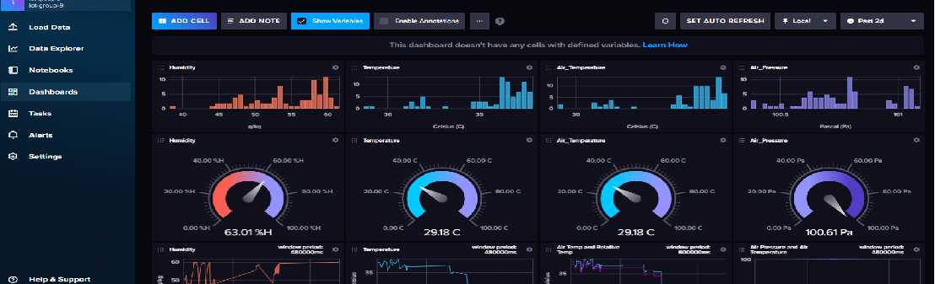
Data Collection and Storage with InfluxDB:
Receive Data: Our system involves multiple sensors connected to ESP32 devices that publish data to an MQTT broker. The broker, in turn, channels this data to the command center.
InfluxDB as Data Sink: From the command center, data is pushed to InfluxDB. My primary role was to ensure that InfluxDB correctly receives and stores these data points. This includes configuring InfluxDB to handle the incoming data flow efficiently, setting up databases, retention policies, and continuous queries to manage the data effectively.
17

Slide 19
Data Visualization with Grafana:
Dashboard Setup: I was responsible for setting up Grafana dashboards that connect to the InfluxDB data source. These dashboards are crucial for visualizing the IoT data collected.
Customizing Visuals: Designing and customizing the Grafana dashboards to display data in an interpretable and meaningful way. This includes selecting the right types of graphs and charts (like line charts, gauges, bar charts) that best represent the time-series data from our sensors.
Real-time Monitoring: Ensuring that the dashboards update in real-time to reflect the most current data from the devices. This involves setting up refresh rates and queries that pull the latest data from InfluxDB.
18

Slide 20
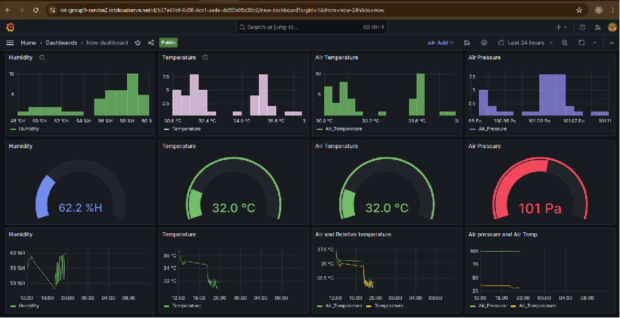
19

Slide 21
Management and Maintenance:
Data Integrity and Availability: Regular checks to ensure data is accurately recorded and readily available for queries and visualization.
Security and Access Controls: Implementing security measures to protect the data and control access to the dashboards, especially if they are to be accessible over the internet.
Link for public to access the data on our dashboard
https://iot-group9-service1.iotcloudserve.net/public-dashboards/f04ab8d463984deda1a90e9c6214295c
20

Slide 22
Overview of the Data Analytics Process:
Dataset Used: Contains columns for Date/Time, Air Pressure, Air Temperature, Temperature, and Humidity.
Models Deployed: Linear Regression and Support Vector Machine (SVM).
Tools and Libraries: Python, Pandas, Scikit-Learn, InfluxDB, Joblib.
21
Notes:
This project involves the development of predictive models to forecast environmental conditions, specifically air pressure, air temperature, general temperature, and humidity. Utilizing a dataset that records these metrics along with time stamps, we applied machine learning techniques to provide accurate predictions that can aid in environmental monitoring and planning.

Slide 23
Data Processing and Training:
Preprocessing Details: Conversion of date-time to Unix timestamp for ease of model processing.
Training Process:
Linear Regression and SVM models were trained on features like the Unix timestamp, excluding target variables (Air Pressure, Air Temperature, Temperature, Humidity).
Models were saved using Joblib for later use in predictions.
22
Notes:
The data processing phase involved converting date-time information into Unix timestamps to facilitate time-series analysis. We segmented the dataset into training and test sets, with 80% of the data used for training the models, ensuring a robust learning process.

Slide 24
Model Evaluation and Performance Metrics:
Evaluation Metrics Used: Mean Squared Error (MSE), R-squared, and Mean Absolute Error (MAE).
Performance Highlights:
Linear Regression showed varying degrees of accuracy across different environmental parameters, with stronger performance in temperature predictions.
SVM demonstrated robustness in handling non-linear relationships, especially effective in humidity predictions.
23
Notes:
Post-training, models were evaluated using standard metrics to assess their accuracy and efficacy in predicting environmental conditions. The performance of both models was quantitatively assessed to determine their viability for deployment.

Slide 25
Real-Time Prediction and Visualization:
Real-Time Prediction Setup:
Models are loaded and predictions are made based on real-time data inputs.
Predictions are written to InfluxDB where they are stored for historical analysis and real-time visualization.
Visualization and Use Case:
InfluxDB dashboards display real-time data along with historical trends and predictions.
This setup is crucial for applications requiring immediate environmental data analysis, such as smart city management and precision agriculture.
24
Notes:
The deployment phase involved setting up a system for real-time data prediction using the trained models. Predictions are stored and visualized in InfluxDB, allowing for real-time monitoring and decision-making.

Slide 26
THANK YOU
DO YOU HAVE ANY QUESTION?

